Slide 1
God’s Family Through The Ages
www.TheRestorationMovement.com

Slide 2
Head Of Gold – Babylonian Empire
Chest & Arms of Silver – Medo-Persian Empire
Middle & Thighs of Bronze – Greek Empire - Alexander
Legs Of Iron With Feet Of Partly Iron & Partly Clay – Roman Empire
In the days of these kings . .
Daniel 2:44

Slide 3
Jesus Taught:
Mark 9:1 – Some Standing Here Will Not Taste Death Before The Kingdom Comes
Matthew 16:13-19 – “Upon This Rock I Will Build My Church . . . And I Will Give Unto You The Keys Of The Kingdom Of Heaven”

Slide 4
On That Day Of Pentecost
Prophecy Fulfilled
vv.16-21 – Joel 2 – God’s Great And Notable Day
vv. 25-28 – Psalm 16:8-11 – David’s Prophecy
Church Starts – v.38-40
Kingdom Rule Begins Thru Apostles’ Binding Authority, cf. v.42-47 with Matthew 16:18,19

Slide 5
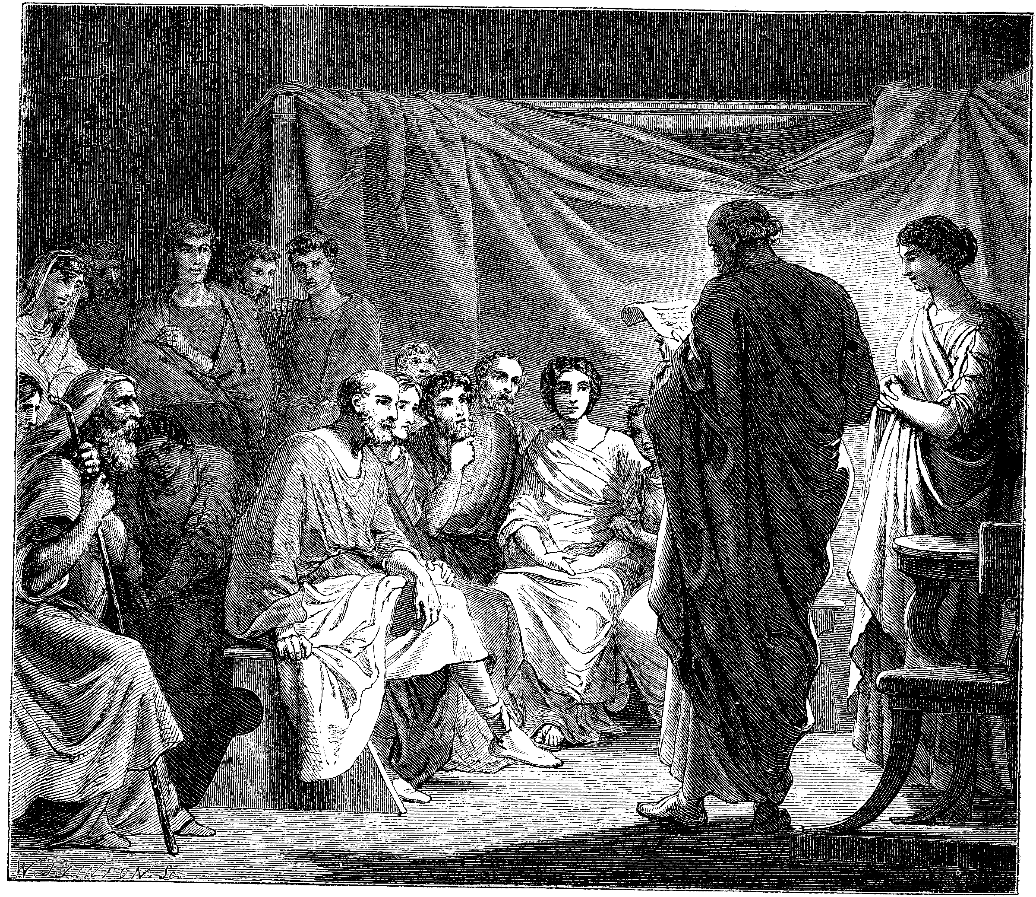
Problems In The Church Required Letters
1 & 2 Corinthians
Disunity Through Partyism
Taking Brothers To Law
Incest
Denial Of The Resurrection, etc.
Colossee – Mysticism, Gnosticism
Revelation – 7 Churches – All With Problems
Acts 20:28ff – Paul’s Warnings

Slide 6
Departures
Development of the Papacy

Slide 7
The Johannes Gutenberg Printing Press - 1454
Arguably History’s Greatest Invention
Produced In Mainz, Germany
First Produced Book: The Bible

Slide 8
The Age Of Enlightenment & The Reformation
John Wycliffe – English Reformer (1329-1384)
Jan Hus – 1373-1415 — Prague, Czechoslovakia
Martin Luther – 1483-1546 - Germany
Girolamo Savonarola —1452-1498, Florence, Italy
William Tyndale — 1494-1536 English Reformer
Ulrich Zwingli – (1484-1531) — Geneva, Switzerland
John Calvin – 1509-1564 — Another Swiss Reformer

Slide 9
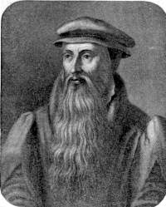
John Knox 1505-1572
John Calvin 1509-1564
Calvin’s Influence In The Reformation In Scotland

Slide 10
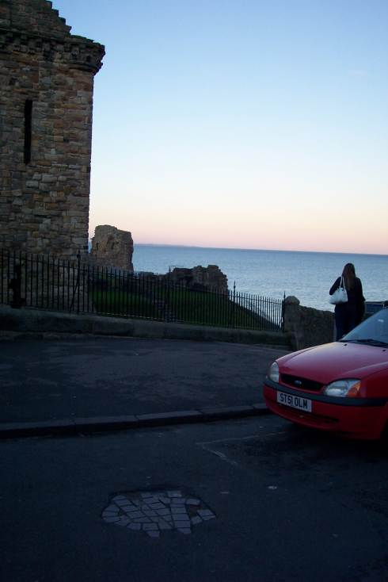
Death of George Wishart
Burned At This Place By Cardinal Beaton, St. Andrews, Scotland March 1, 1546
1513-1546

Slide 11
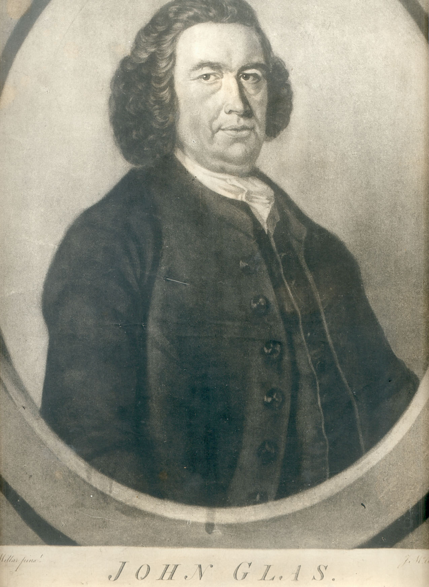
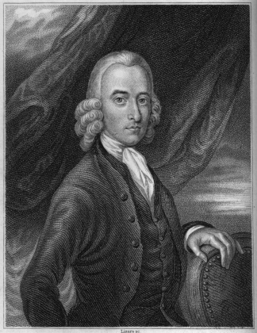
John Glas 1695-1773
Fathers Of Congregationalism
Robert Sandeman 1718-1771

Slide 12
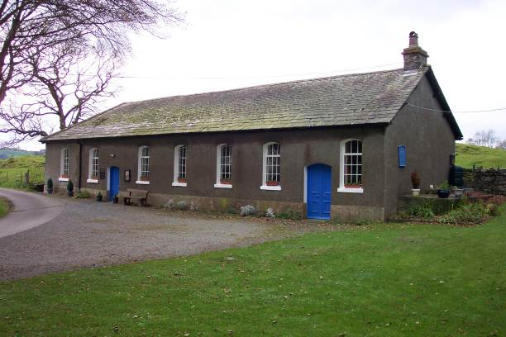
Tottlebank Church
A church of Christ
-early as 1669

Slide 13
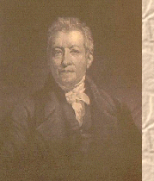
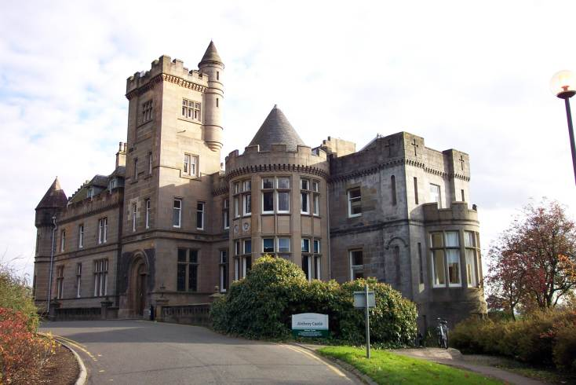
Robert & James Haldane
Baptist Ministers Who Brought About Reform In The British Isles
James Haldane 1768-1851
Airthrey Castle, Sterling, Scotland Haldane Home

Slide 14
Greville Ewing
Haldanian revivalist who influenced thousands through Saturday schools
Also, a young Alexander Campbell in 1808-1809
Greville Ewing 1767-1841
Pollock House, Scotland, Home Of Greville Ewing

Slide 15
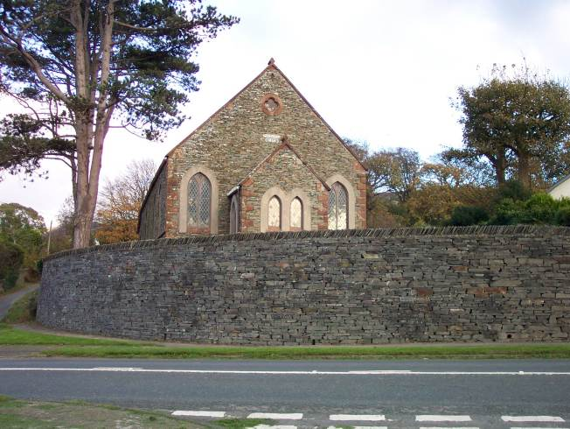
Kirkby Church of Christ
By 1824 a church after the ancient order was serving the Lord at Kirkby.
It was 30 years before any hear of Barton W. Stone or Alexander Campbell

Slide 16
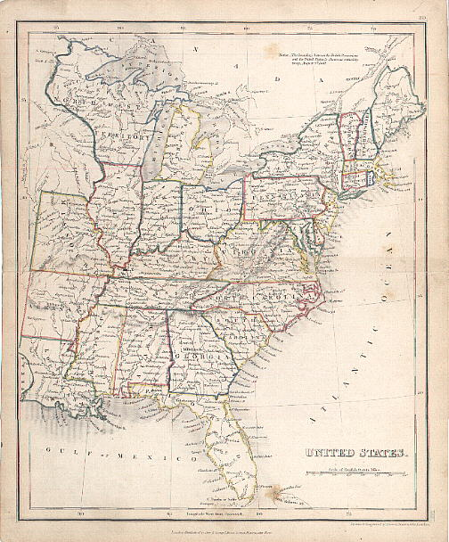
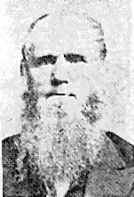
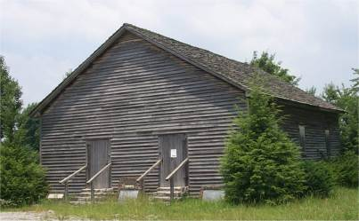
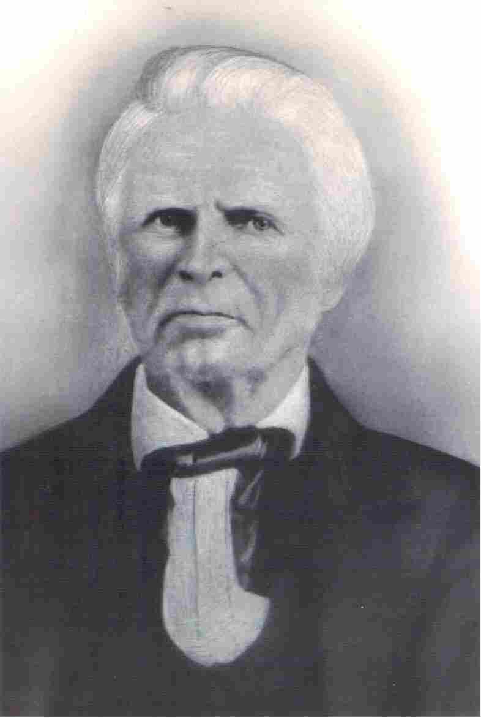
Many Independent Movements
Old Philadelphia
Warren Cty. TN
Dr. Chester Bullard
1809-1893
1805
John Taylor
Christian H. Dasher
1807-1895
1789-1866

Slide 17
Second Great Awakening: Religious Revival In America
1797-
-1801
James McGready (1763-1815) Presbyterian minister introduced religious revival in Logan County, Kentucky

Slide 18
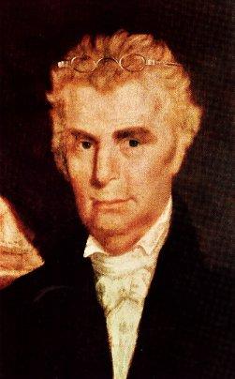
The Work And Influence Of Barton W. Stone

Slide 19
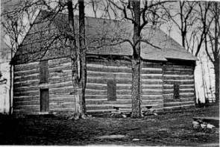
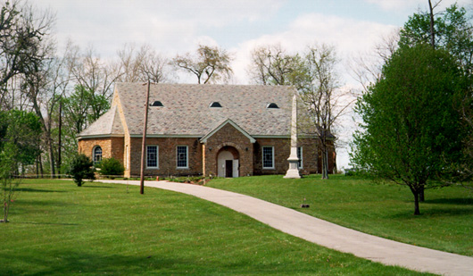
Cane Ridge Revival August 14-19, 1801

Slide 20
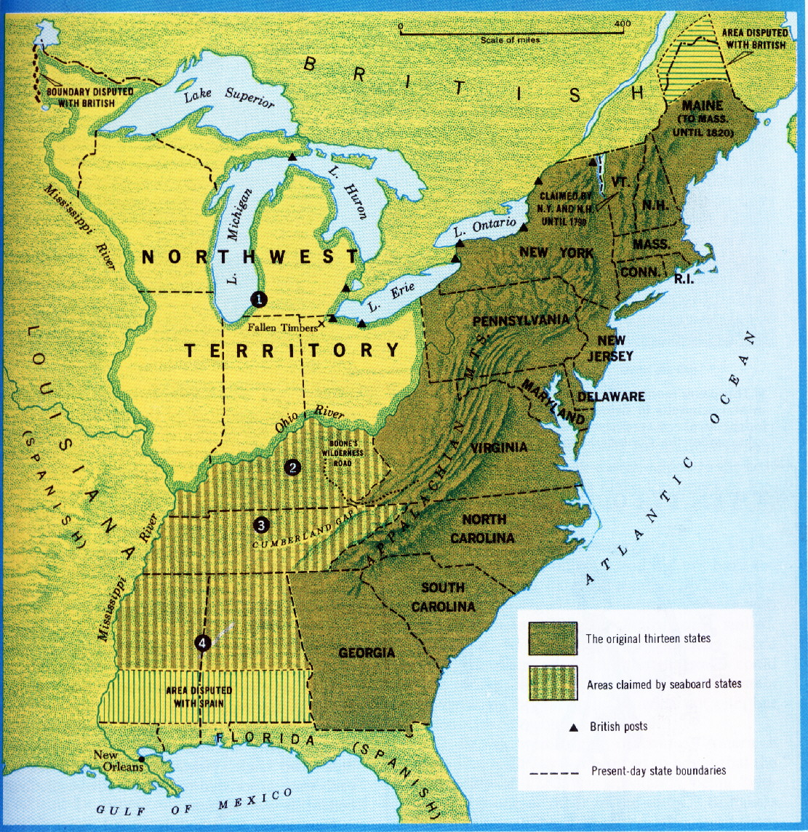
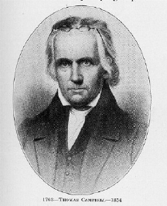
The Influence Of Thomas & Alexander Campbell
1809, Thomas & Alexander Campbell, Bethany, Virginia
Thomas Campbell 1763 - 1854

Slide 21
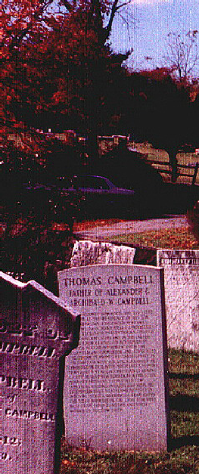
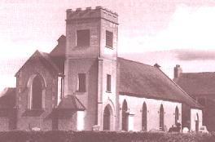
Thomas Campbell 1763 - 1854
The Presbyterian Church in Ahorey, Northern Ireland where Thomas Campbell preached before moving to the United States. The bell tower is not original.
Thomas Campbell born February 1, 1763 in Newry, County Down, Ireland. Arrived here May 13, 1807. A Presbyterian preacher who through study of the Bible saw the need to preach it and live wholly under its authority. Now buried at God’s Acre, Bethany, West Virginia next to his son, Alexander.

Slide 22
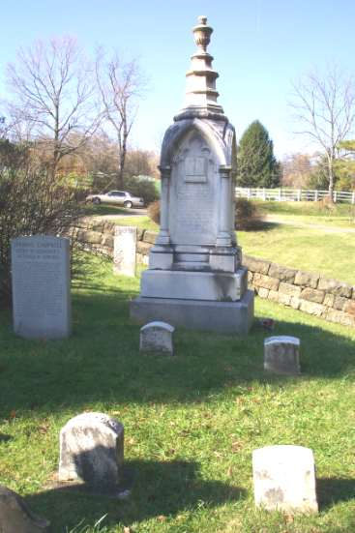
Alexander Campbell 1788-1866

Slide 23
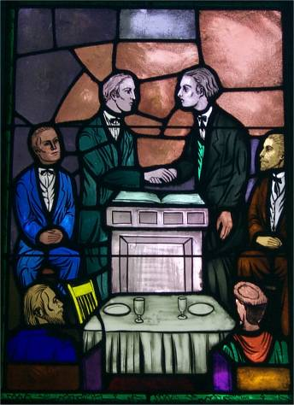
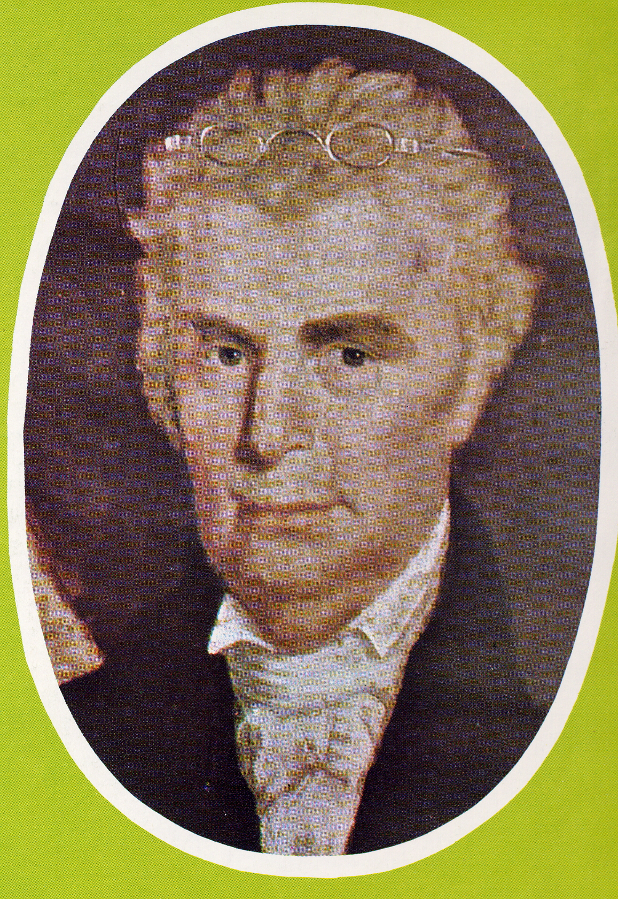
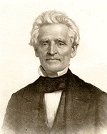
Coming Together Of A Movement
Meeting Of Stone’s Christians & Campbell’s Disciples At Hill Street Church In Lexington, Last Week In 1831 with 10,000 members in Kentucky
January 1, 1832 Joined Forces With A. Campbell’s Disciples Movement
“Let us, then my brethren, be no longer Campbellites or Stoneites, New Lights or Old Lights, or any other kind of lights, but let us come to the Bible, and to the Bible alone, as the only book in the world that can give us all the light we need.” — John Smith
Hill Street Church, Lexington, Kentucky
“Raccoon” John Smith

Slide 24
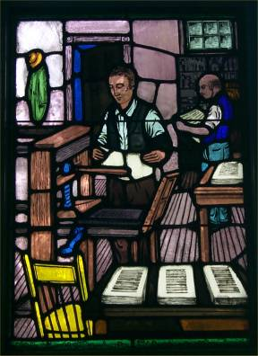
The Printing Press Contributed To Union
B.W. Stone’s 1826 Christian Messenger A. Campbell’s 1830 Millennial Harbinger Distributed The Message Of Union Among Christians, Later Others Like 1884 Firm Foundation & 1855 Gospel Advocate Continued The Unity Call

Slide 25
Christian Education
1834 – Bacon College, Georgetown, Kentucky, seed school of University of Kentucky
1840 – Bethany College, Virginia
1843 – Franklin College, Tennessee
1869 – Henderson, Tennessee, Henderson Male & Female Institute Begins, Later Freed-Hardeman University
1891 – Nashville Bible School Begins, Later Lipscomb University
1901 – Potter Bible College begins with J.A. Harding as president

Slide 26
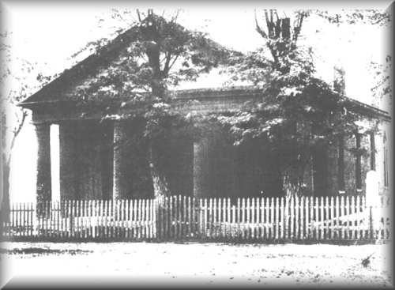
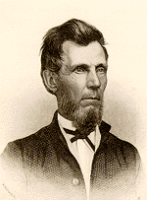
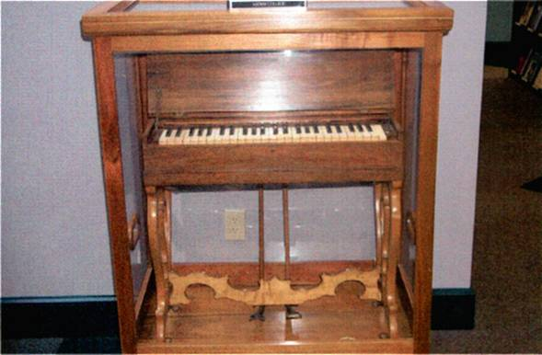
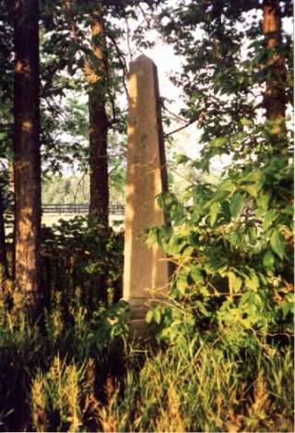
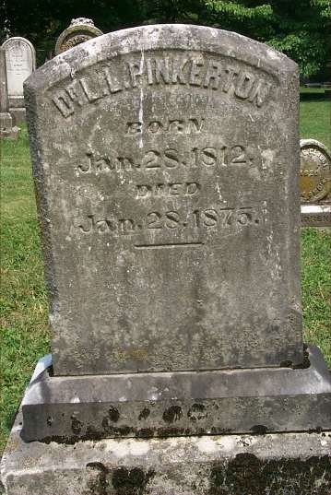
1860 — The Incident At Midway, Kentucky
Adam Hibler Grave
L.L. Pinkerton Grave

Slide 27
Other Things Contributing To Division
American Christian Missionary Society – 1849
The Civil War – 1861-1865
1866 Christian Standard Begins With Isaac Errett As Editor – Devoted To A More Progressive Approach To Christianity

Slide 28
Splintering Continues In The 20th Century
March, 1917 Major Controversy In The College Of The Bible Exists Over The Subject Of Higher Criticism, Leading To A Major Split Among Christians, Enter: The Disciples Of Christ
1920s Controversies With R.H. Boll Over Premillennialism
1930s & 40s Relative Quietness Due To Economic Depression & War
1950s To 1970s Battles Over Support Of Institutions/Sunday School/Located Preachers/Christian Colleges/etc.
1980 To Today – The Change Movement – New Hermeneutics/Worship Styles etc.

Slide 29
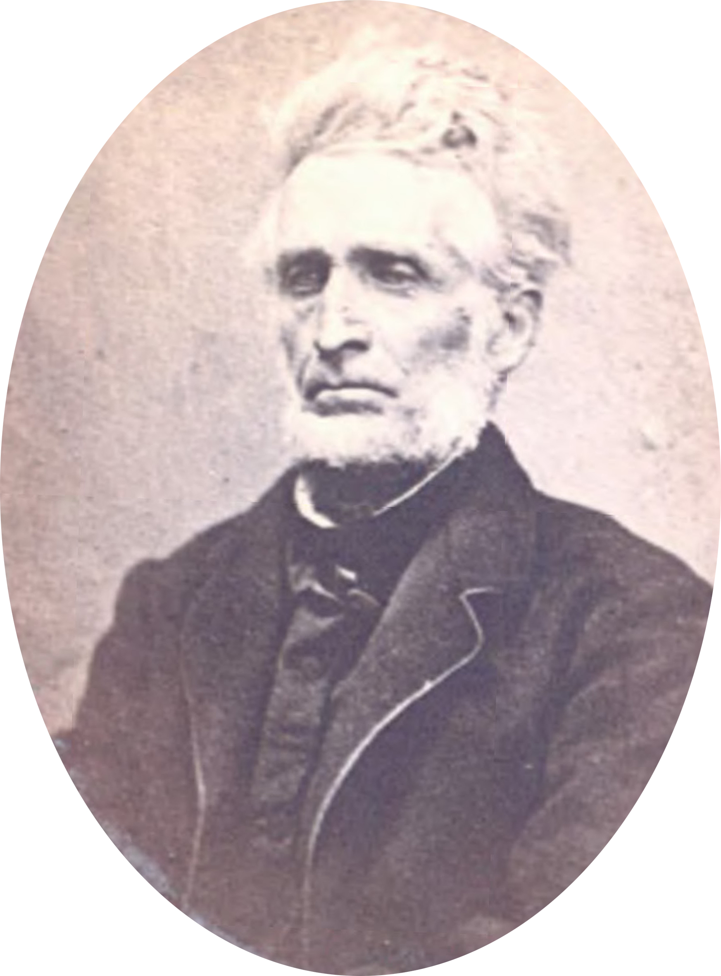
Two Of Many Preachers Who Made A Difference Early In Logan County In The Early Days Of The Restoration
George W. Elley 1801-1884
John T. Johnson 1788-1856

Slide 30
1842 – News Sent To Alexander Campbell
George W. Elley
Alexander Campbell
Millennial Harbinger, Nov. 1842

Slide 31
1842 – News Sent To Alexander Campbell
George W. Elley
Alexander Campbell
Millennial Harbinger, Nov. 1842

Slide 32
1842 – News Sent To Alexander Campbell
George W. Elley
Alexander Campbell
Millennial Harbinger, Nov. 1842

Slide 33
What Logan County Brethren Looked For In A Preacher
Alexander Campbell
Millennial Harbinger, Nov. 1858

Slide 34
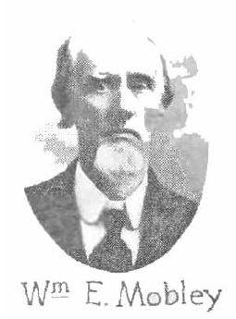
William E. Mobley 1824-1911
W.E. Mobley
Alexander Campbell
Millennial Harbinger, December, 1852, p.716
Millennial Harbinger, Nov. 6, 1866, p.711
Millennial Harbinger, Nov. 1858

Slide 35
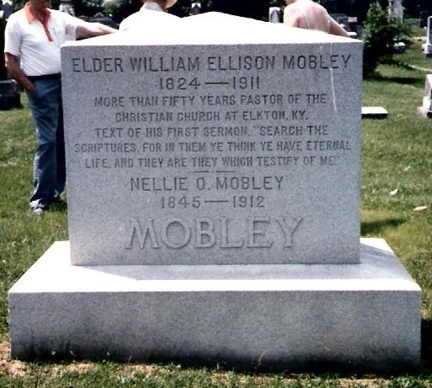
William E. Mobley 1824-1911
W.E. Mobley
Glenwood Cemetery, Elkton

Slide 37
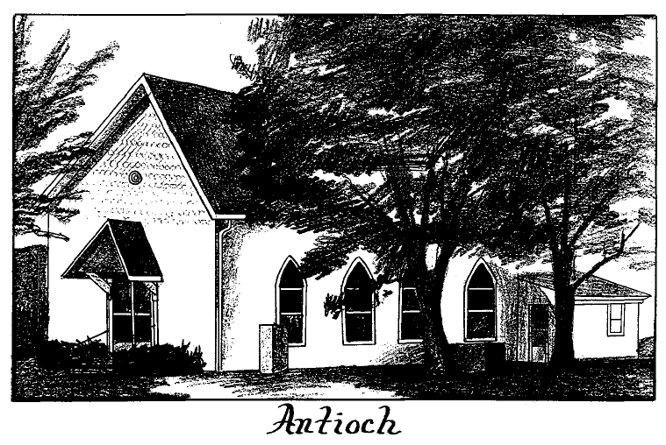
The work at Schochoh – 1869

Slide 38
Old Antioch & New Antioch
Oral history indicates that a Baptist church was converted in the establishment of the congregation. 20 members left Berea to assist. – 1870 (Turner, p.15)
1896 – the land is sold and new property, different (present) location, was built. It was called New Antioch after this. The deed of the new building indicates why. (Turner, p.17)
Today called Schochoh Church of Christ

Slide 39
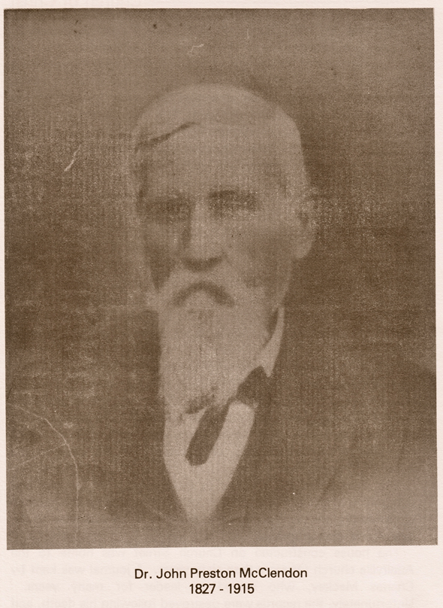
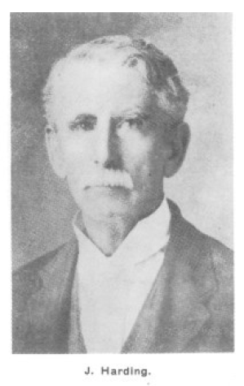
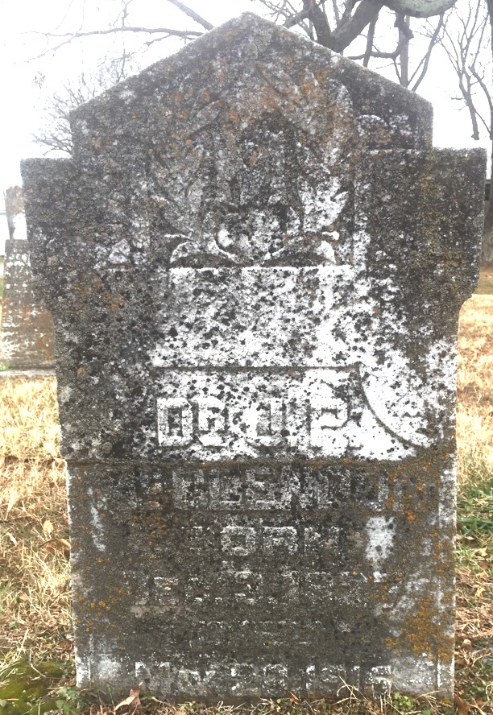
”Weeping” Joe Harding 1839-1915
Dr. J.P. McClendon 1827-1915 New Hope Baptist church cemetery east of Adairville
Gospel Advocate, November 1881, p710

Slide 40
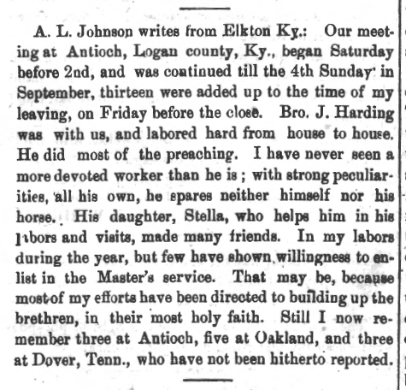
While At PBC
His son-in-law, J.N. Armstrong joins the faculty of the school (the father of Harding University)
Students came from all over to attend the college.
J. Pettey Ezell, J. G. Malphurs, Coleman Overby, J. P. Prevatt,
The Hines Brothers: W. T. Hines, and J. H. Hines, & Jacob L. Hines
”Weeping” Joe Harding 1839-1915
Gospel Advocate, October 1884, p630

Slide 42
When Did Bethany Begin?
Marie Turner dismisses the 1840 founding of Bethany mentioned by George W. Elley in Millennial Harbinger as being a different congregation. p.6
J.V. Orndorff, in his history of Berea Christian Church states that the William Boyd family moved to Olmstead community in 1870.
D.C. Dawson family moved to Bethany around 1874, but their name was still on the church roll at Antioch in 1896.
The earliest date of confirmation Marie Turner could find was from the deed on the Bethany property as being May 31, 1897

Slide 43
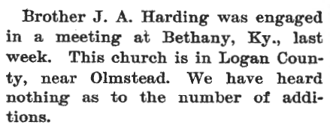
Earliest mention in the GA
J.A. Harding 1848-1922
Gospel Advocate, September 1896, p584

Slide 44
Other Meetings At Bethany
Gospel Advocate, October 1897, p648
F.B. Srygley 1859-1940
Gospel Advocate, March 1904, p133

Slide 45
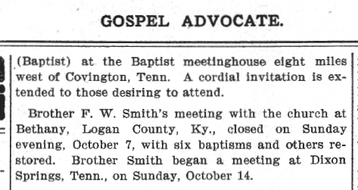
Other Meetings At Bethany
Gospel Advocate, October 1897, p648
F.W. Smith
1858-1930
Gospel Advocate, October 1906, p661

Slide 46
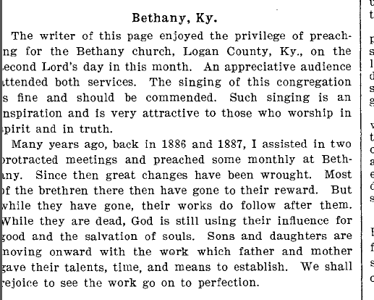
Other Meetings At Bethany
J.C. McQuiddy
1858-1924
Gospel Advocate, April 1915, p389

